Slide 1

Traffic And Accident Patterns in NYC
By: Joshua Rifkin
IS 362
Fall 2020
Notes:
Hi, My name is Joshua Rifkin and for my final project I decided to analyze traffic accident patterns in NYC. As a resident who has been living here for several years and who drives almost every day, this research is something that I felt connected to that would give me better insights into the every day driving habits of my fellow New Yorkers.

Slide 2

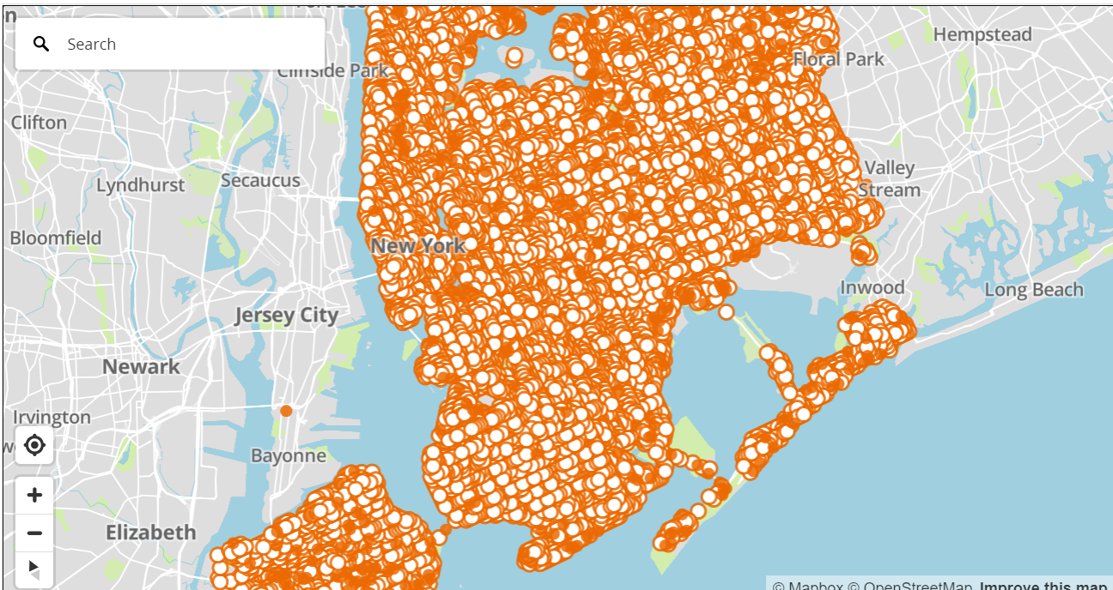
Notes:
This slide was made by mapping every accident in my data – retrieved from NYC Open Data – using GIS, or Geographic information Systems. As you can see, there are far too many accidents to be able to learn very much from just this map. In the following slides we will break this data down further by use of Python, Pandas, and Seaborn.

Slide 3
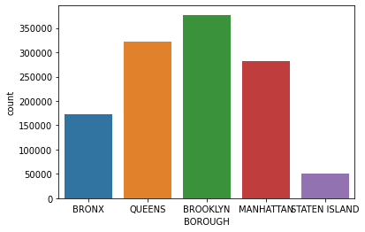
Number of Accidents Per Borough
Notes:
The first logical step in breaking down this data was to separate it out by graphing the number of accidents per borough. As can be seen in the graph, the majority of accidents took place in Brooklyn, closely followed by Queens and Manhattan. The Bronx and Staten Island had the second lowest and lowest number of accidents, respectively. As a resident of Brooklyn and a previous resident of Manhattan, I was actually a little shocked by this. I personally would have thought that Manhattan would have been higher on the list considering the number of drivers and the kind of congestion you find on New York City streets. I personally always found it harder driving through Manhattan than I did Brooklyn.

Slide 4
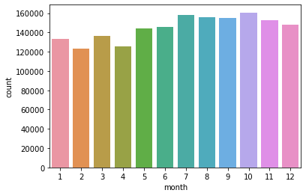
Number of Accidents by Month
Notes:
The next step I took was to break down the data by Month. Here, I was looking for a pattern. I was wondering whether accidents tended to take place more in the winter months, when driving conditions tend to be harsher. As it turned out, the highest number of accidents occurred between the months of July and October. I do not have a good explanation for why this may be. Perhaps it correlates to some other factor that is outside the scope of this project.

Slide 5
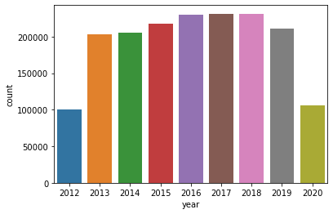
Number of Accidents by Year
Notes:
Next I graphed the number of accidents per year. With more and more cars on the road every year, one might expect the number of accidents to increase per year. In the graph here, we can see that this assumption tends to hold true. The number of accidents did in fact slowly increase over the years. With regard to 2012 and 2020, there may be some explanation. The database that this data was pulled from was created in 2014. Chances are likely that the data for 2012 is incomplete and therefore shows as far lower than the other years. With regard to the year 2020, the data is not yet complete. While it may be close to the end of the year, we are still in 2020 and the data may not have been entered into the database yet.

Slide 6
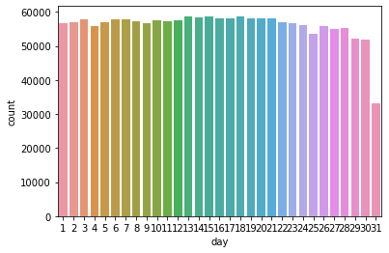
Number of Accidents by Day of the Month
Notes:
The sixth graph displays the number of accidents that occurred by the day of the month. I was curious whether certain times of the month tended to be more likely to have accidents. As it turned out, accidents tended to be spread out rather evenly. The 31st day tended to have far fewer accidents, however only 7 out of the 12 months have 31 days, which will account for the lower number of accidents on that day.

Slide 7
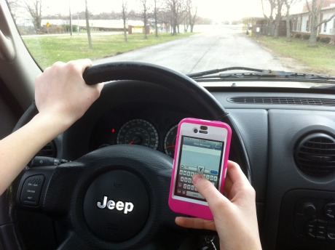
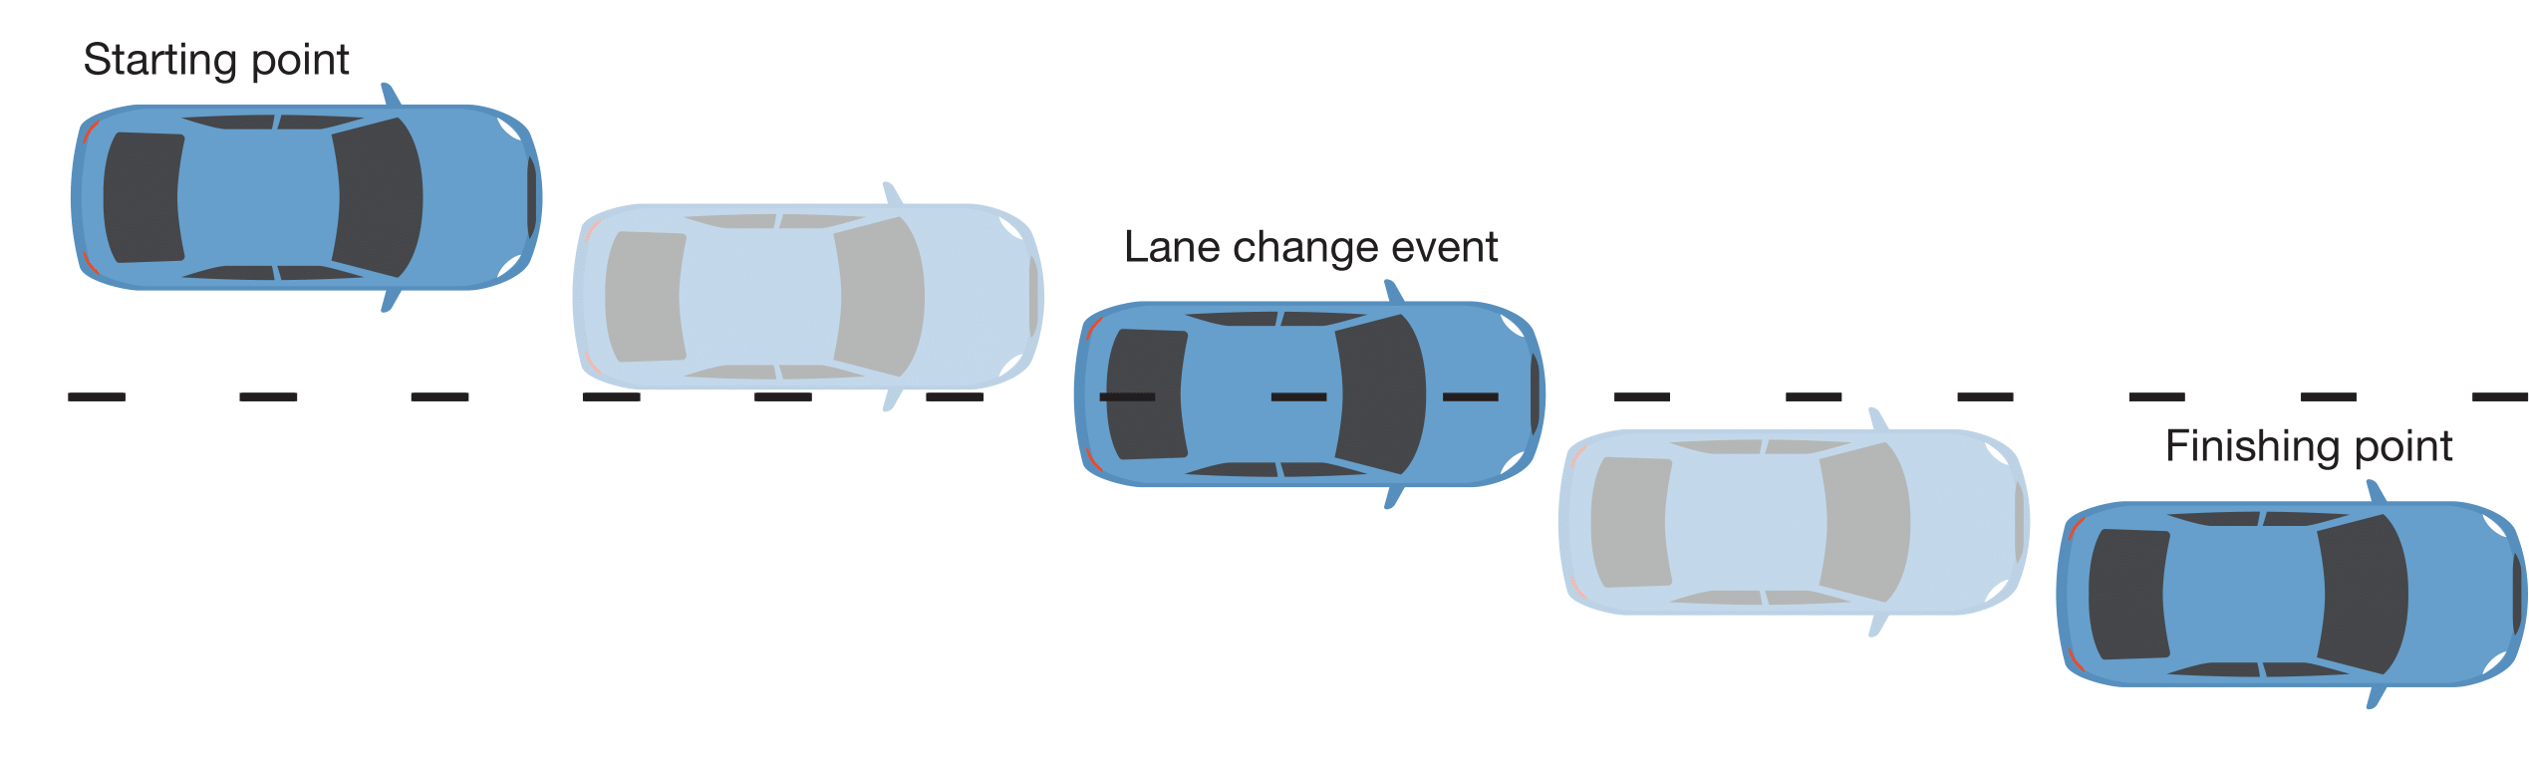
Most Common Accident Causes
Unspecified 624412
Driver Inattention/Distraction 332525
Failure to Yield Right-of-Way 100010
Following Too Closely 89217
Backing Unsafely 66278
Other Vehicular 54959
Fatigued/Drowsy 47005
Turning Improperly 43601
Passing or Lane Usage Improper 42897
Passing Too Closely 39322
Notes:
In this slid we see a list of the most common primary causes of accidents. This is where we are able to start learning the most about car accidents. The number one cause - “unspecified” - is simply when a cause was not listed. As such we can ignore this item as there is nothing to learn from it. The next most common cause, by far, is driver inattention or distraction. The next most common causes can be clearly seen listed out on this chart. However, all of the most common causes have a common thread, they are all due to the driver behaving in an inappropriate way behind the wheel. Meaning, most accidents are not a result of road rage or caused on purpose.

Slide 8
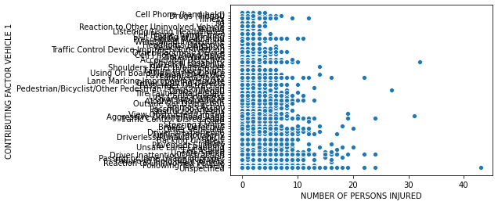
Comparing Accident Cause to # Injured
Notes:
This graph compares the primary accident causes with the number of people injured in the accident. As you can see, most accidents do not tend to injure too many people, however there are obviously outliers.

Slide 9
Conclusion
As can be seen in the graphs in the preceding slides, driving can lead to accidents whenever or wherever you are. There does not seem to be any correlation between time and location with regard to whether an accident will occur. Sure, accidents are more common in Brooklyn and Manhattan than they are in Staten Island, but you must also consider that there are far fewer cars on the road in Staten Island than there are in Brooklyn. However, there is a strong correlation between inattentive driving or inconsiderate driving and accident occurrence. We must remember to always be careful, attentive, and considerate drivers, regardless of when or where we are driving.
Notes:
In conclusion, as can be seen in the graphs in the preceding slides, driving can lead to accidents whenever or wherever you are. There does not seem to be any correlation between time and location with regard to whether an accident will occur. Sure, accidents are more common in Brooklyn and Manhattan than they are in Staten Island, but you must also consider that there are far fewer cars on the road in Staten Island than there are in Brooklyn. However, there is a strong correlation between inattentive driving or inconsiderate driving and accident occurrence. We must remember to always be careful, attentive, and considerate drivers, regardless of when or where we are driving.

